Slide 1
Transfer of Energy Through Waves

Slide 2
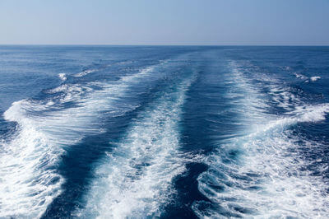
When you have completed this lesson you should be able to:
Understand how waves transfer energy.
Recall the properties of a mechanical wave.
Describe the difference between a continuous wave and a wave pulse.

Slide 3

What is a wave?
We have all heard the term "wave" used to describe many things. We can hear waves of sound and surf on waves of water. But what exactly is a wave and how can it transfer energy from one object to another?

Slide 4
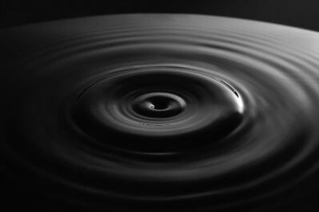
Transfer of Energy
There are two ways in which energy can be transferred from one place to another:
By the movement of matter.
By wave motion between two places.

Slide 5
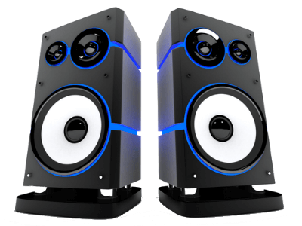
Energy can also be transferred by wave motion.
When you listen to music through a speaker you can hear sound. This sound is transferred from the speaker to your ear through wave motion.

Slide 6

When a speaker produces music it vibrates back and forth.
As it moves forward, it pushes on the closest air particle. This air particle in turn pushes on the next and so on. This is demonstrated at the beginning of the animation below.
As the speaker moves backward, it pulls the closest air particle back with it. This air particle in turn pulls on the next air particle and so on. This is demonstrated at the end of the animation below.

Slide 7
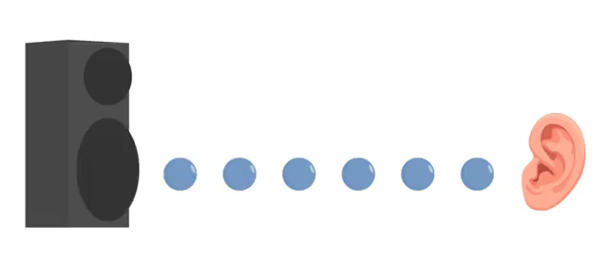
As the speaker vibrates, it vibrates the closest air particle which in turn vibrates the next air particle.
This continues until there are no more air particles. If you place your ear in the path of the vibrating air particles, the air particle closest to your ear will vibrate your eardrum. This vibration of your eardrum is how you perceive sound.
In this example sound energy has transferred from the speaker to your ear via wave motion!

Slide 8

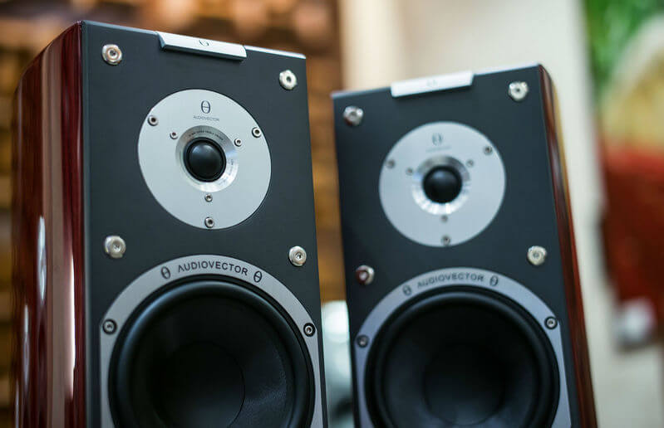
The most important thing to remember when discussing wave motion is that there has not been a transfer of matter!
When listening to the speaker you hear sound (and sound energy has transferred) but you do not feel any wind on your ear (which would be the equivalent transfer of matter).
All waves transfer energy without transferring matter!

Slide 9
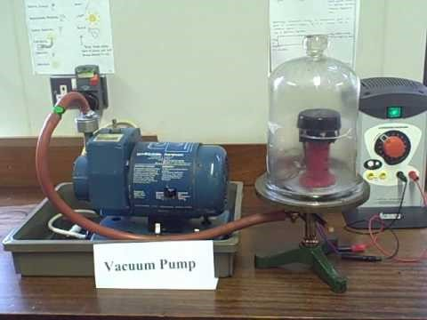
In our previous discussion of sound waves we learned that the waves vibrate air particles.
If there are no air particles to vibrate then the sound wave cannot travel and no sound will be heard.

Slide 10
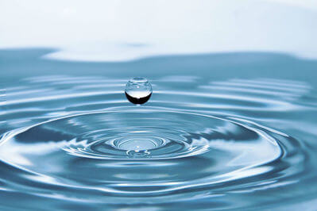


Sound waves are an example of mechanical waves.
A mechanical wave is defined as a wave that requires a medium to propagate¹ and therefore cannot propagate through a vacuum.
¹To propagate means to move or travel and is used when describing wave motion.
A medium is a physical substance such as air, water, glass, earth, etc. Sound waves can travel through air, water and some solids (mediums) but cannot travel through space (a vacuum).

Slide 11
Another common example of mechanical waves are water waves.
Water waves are generated in the deep ocean by strong winds. These waves can then transport the wind energy to shore by moving subsequent water particles up and down. However, each of these water particles stay in the same location in the deep ocean and do not travel with the wave to shore.

Slide 12

When waves propagate they involve regular repetition of the same motion.
For example, sound waves vibrate air particles and water waves move water particles up and down.
In physics we refer to this type of motion as periodic. All waves propagate with periodic motion.

Slide 13
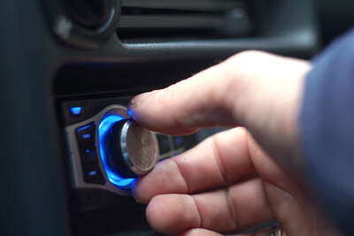
If we continue to generate sound waves we refer to them as a continuous wave.
Continuous waves may also be referred to as travelling waves.
The size of a continuous wave decreases the further we get from the wave source. This is because the waves gradually lose energy to the environment. This phenomenon can happen to any type of wave and is not restricted to only continuous waves.
When listening to music from a speaker, we are observing a continuous wave. If we stand close to the speaker, we hear loud music as most of the sound energy reaches our ear. If we stand far from the speaker we hear very quiet music as most of the sound energy has been lost to the environment as heat.

Slide 14
If we start and stop our music very quickly we generate a pulse of sound.
This pulse¹ of sound will be transferred through the air by each individual air particle undergoing one vibration (one forwards and backwards movement).
¹A pulse is a wave of short duration.
A pulse of water will cause each individual water particle to move up and down once and then return to its original position.

Slide 15
